Slide 1
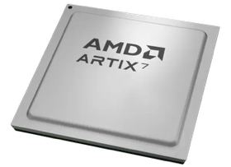
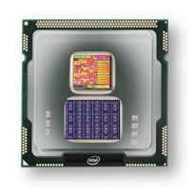
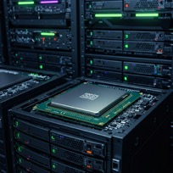
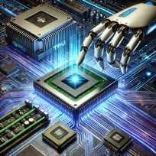
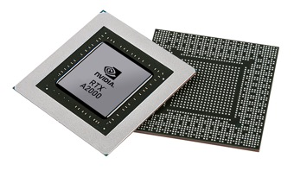


Christof Teuscher
ECE 410/510: Hardware for AI and ML
Initial steps with project
Portland State University
Department of Electrical and Computer Engineering (ECE)
www.teuscher-lab.com
teuscher@pdx.edu

Slide 2
Goal: get you started (if you are stuck)
Pick an interesting code/workload. E.g., see examples:
QR code recognition
Reinforcement learning (FrozenLake problem)
DeepSpeech (speech-to-text engine, pre-trained)
Analyze and benchmark the code to identify possible bottlenecks.
Determine total execution time = baseline for HW/SW comparison.

Slide 3
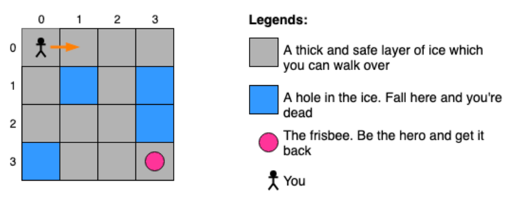
Scale the problems up to understand better
Recognize 1,000, 10,000, 100,000 QR codes
Enlarge the FrozenLake grid and place and add a fixed percentage of holes in the ice (e.g., 5%): 5x5, 10x10, 50x50, 100x100, 1,000x1,000 …

Slide 4
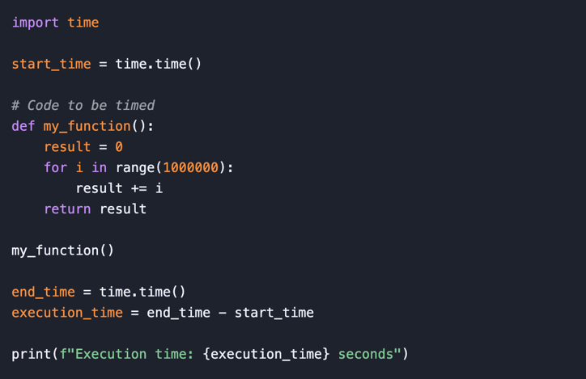
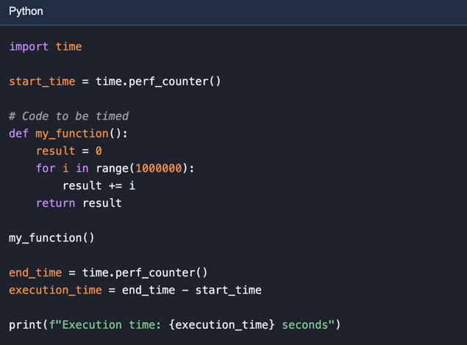
Total execution time (1)
For more precise timing, especially for short durations, time.perf_counter() is recommended. It provides the highest available resolution to measure a short duration.

Slide 5
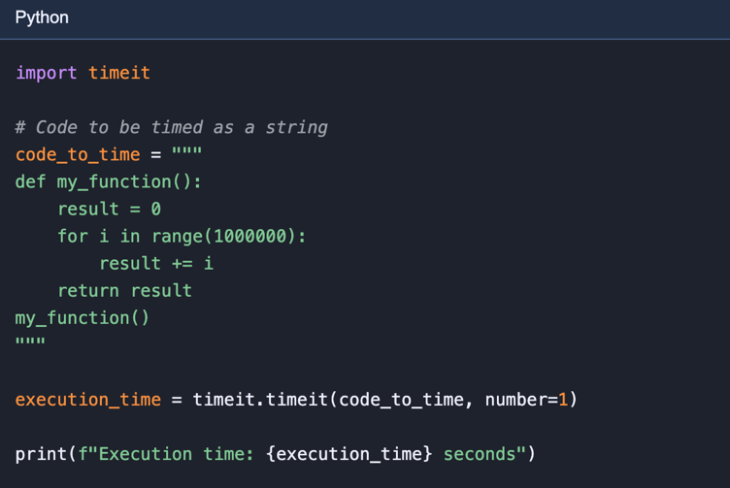
Total execution time (2)
The timeit module is specifically designed for measuring the execution time of small code snippets.

Slide 6
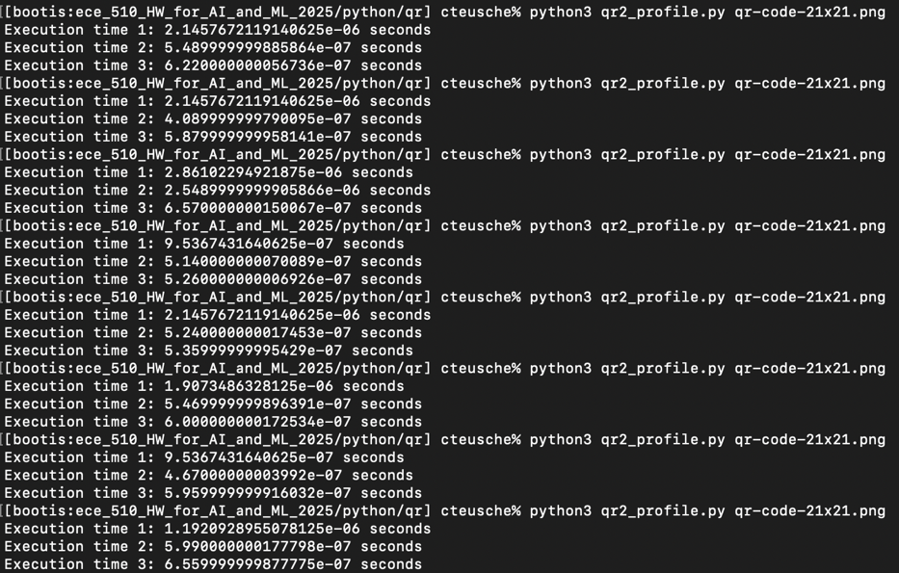
Total execution time (3)

Slide 7
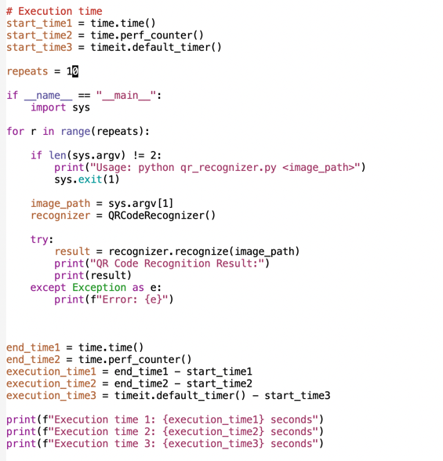
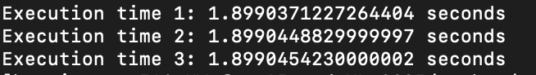
Total execution time (4)

Slide 8
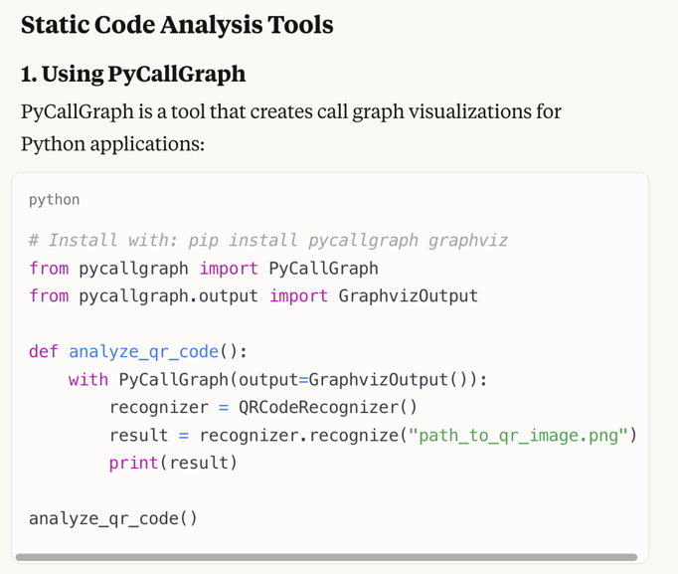
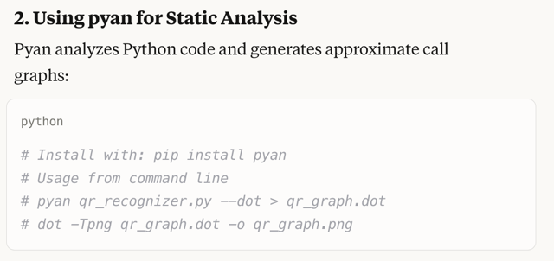
Code analysis (1)

Slide 9
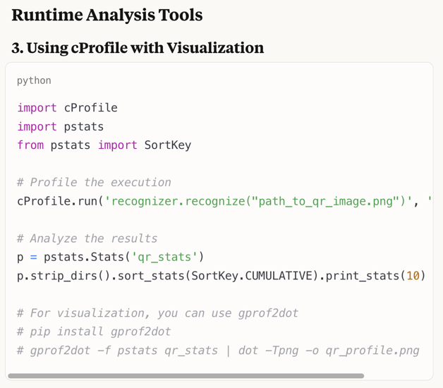
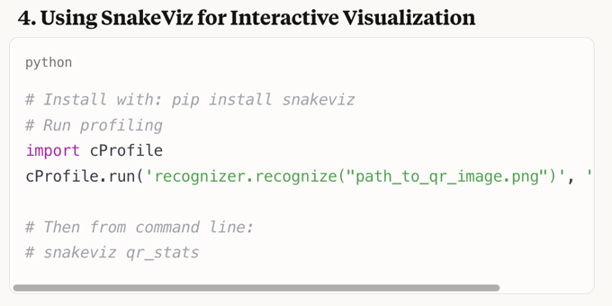
Code analysis (2)

Slide 10
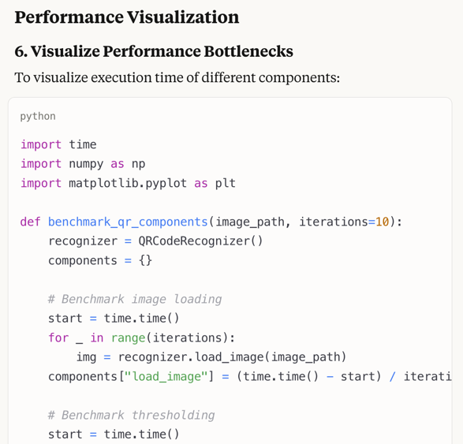
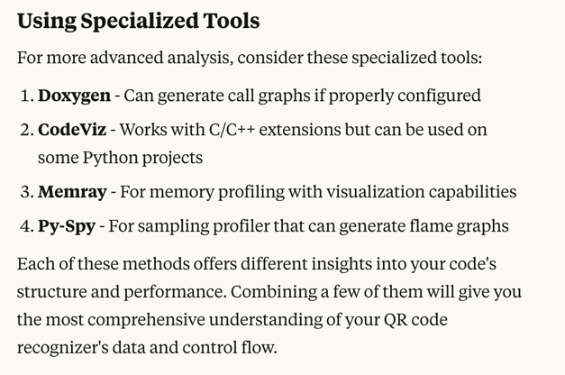
Code analysis (3)

Slide 11
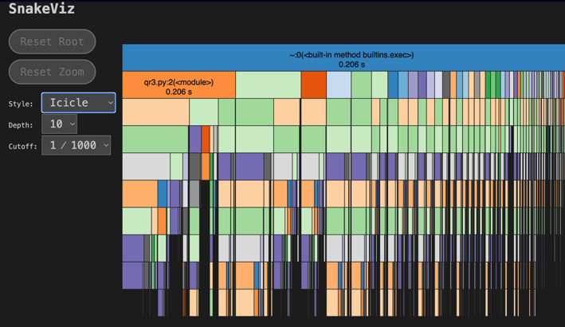
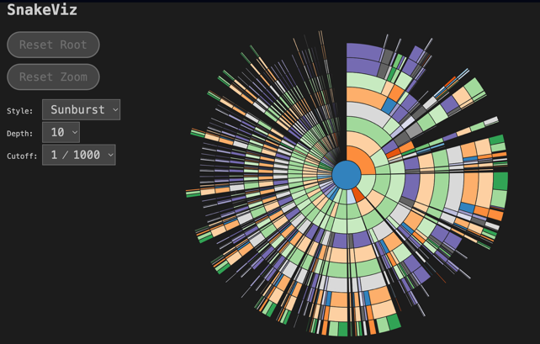
cProfile and SnakeViz
pip install snakeviz
python3 -m cProfile -o output.prof qr_recognizer.py qr.png
snakeviz output.prof

Slide 12
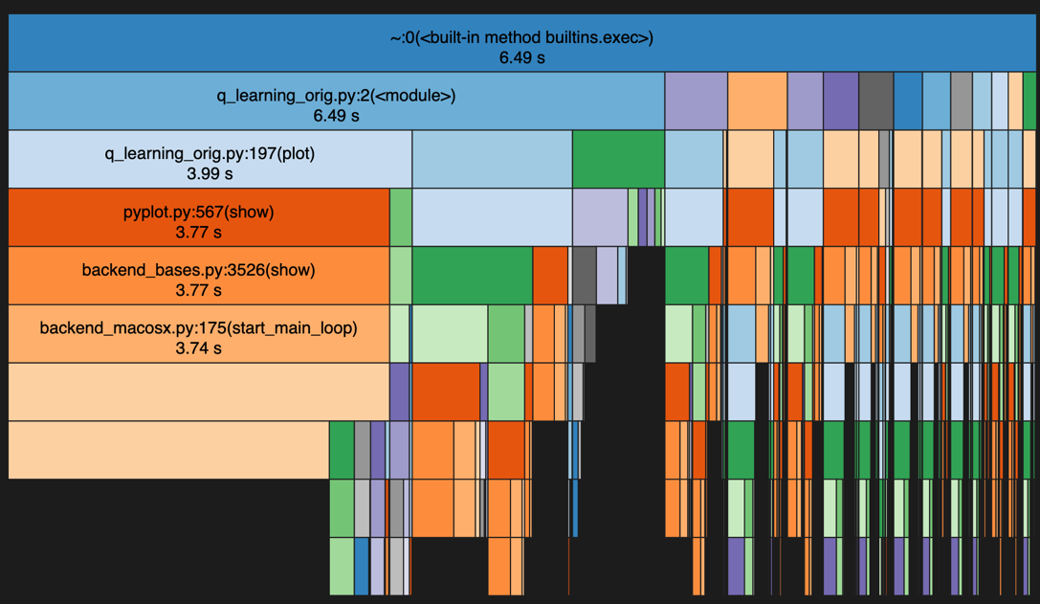

Slide 13
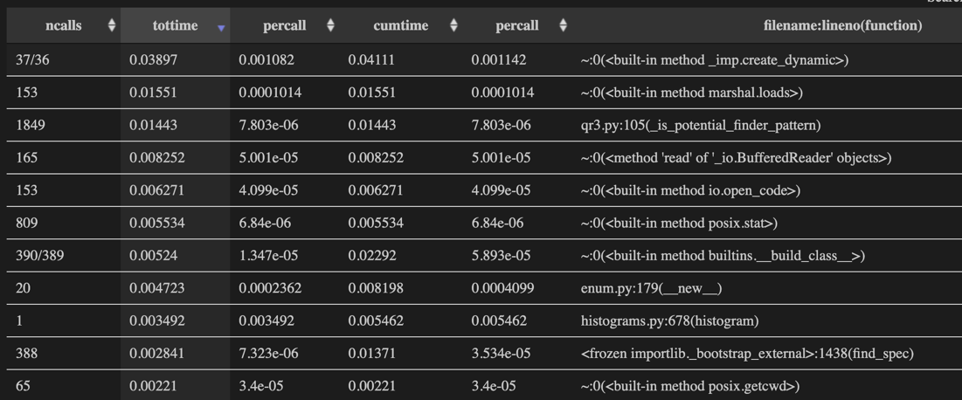
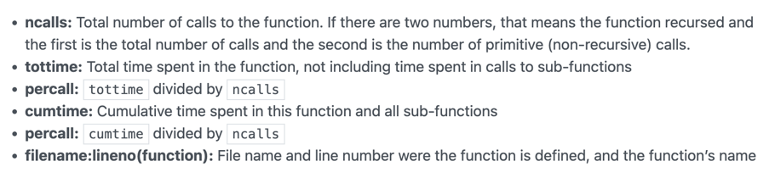

Slide 14
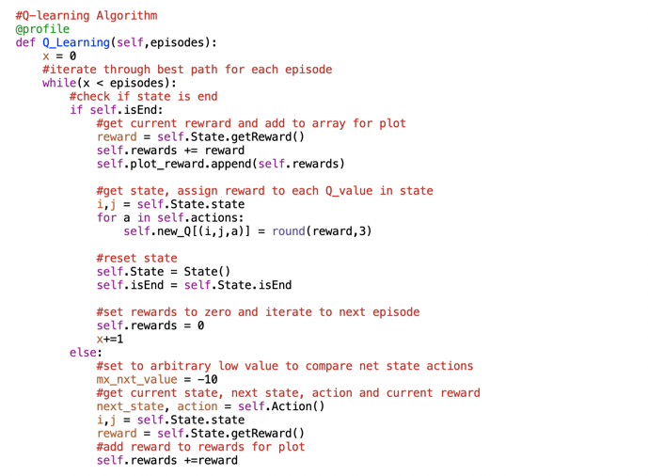
line_profiler
kernprof -l q_learning_profiling.py
python3 -m line_profiler -rmt "q_learning_profiling.py.lprof"

Slide 15
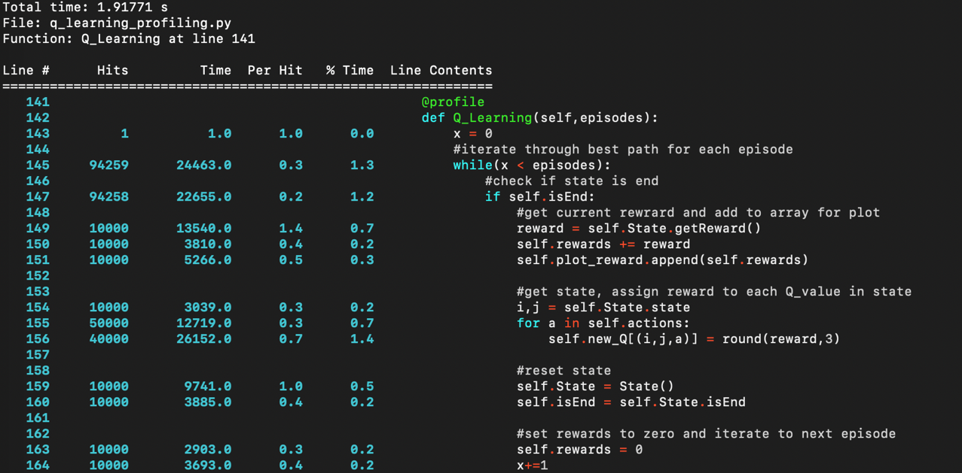

Slide 16
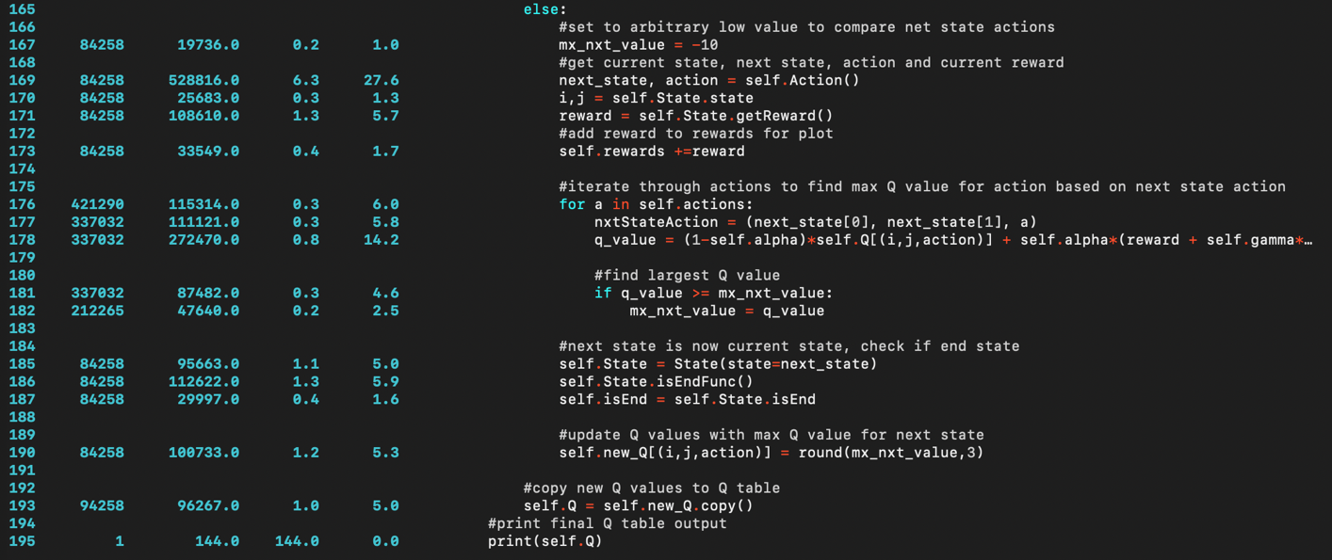

Slide 17
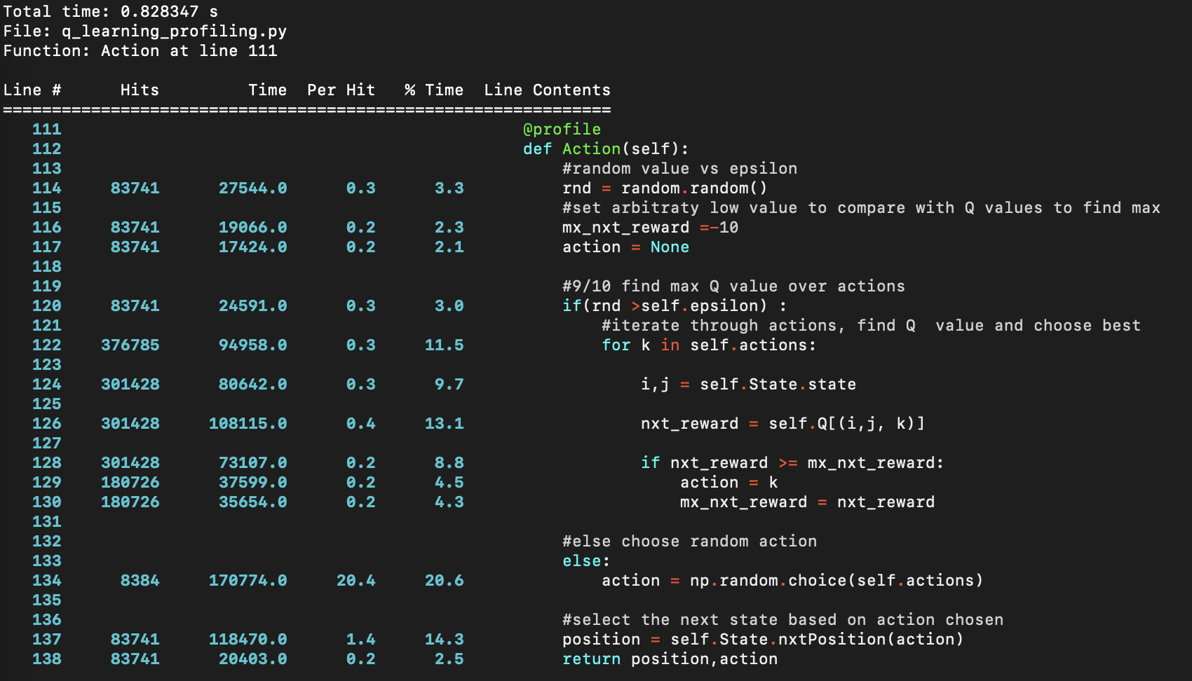

Slide 18
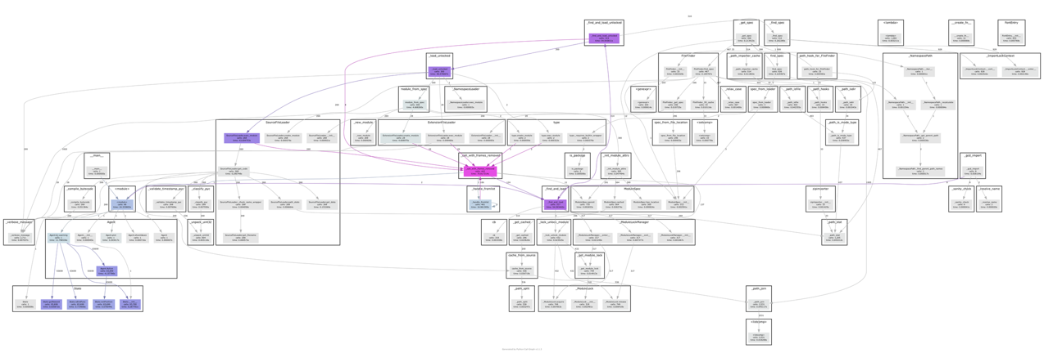
Pycallgraph2: Dynamic Call Graph Generation
Requires pycallgraph2 and graphviz
pycallgraph graphviz --output-file output.png q_learning_orig.py

Slide 19
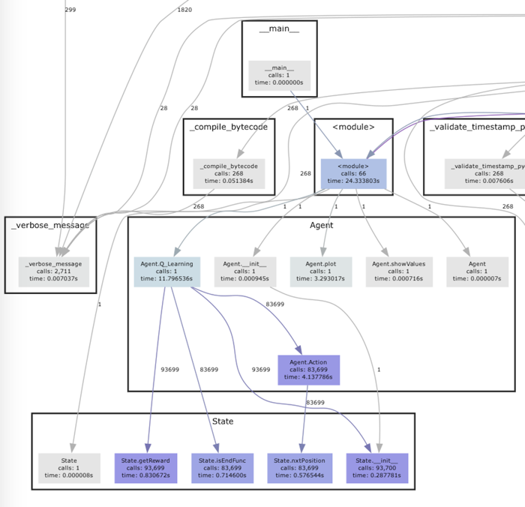

Slide 20
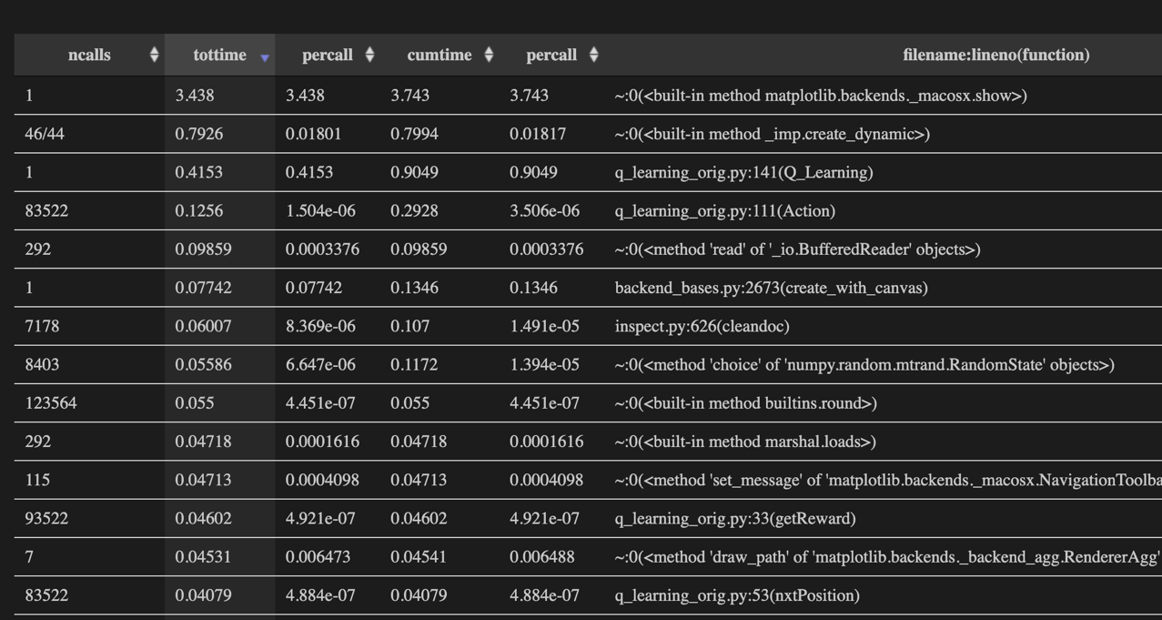

Slide 21
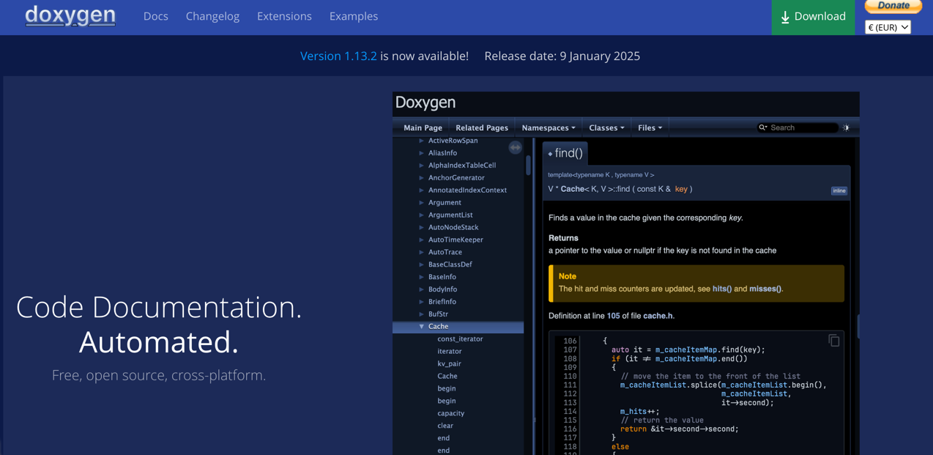
https://www.doxygen.nl

Slide 22

Q learning (1)

Slide 23
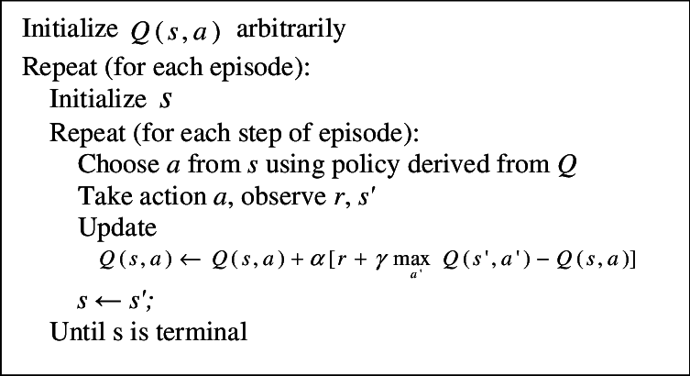
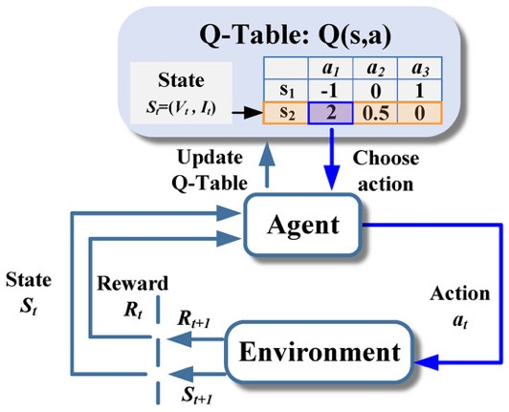
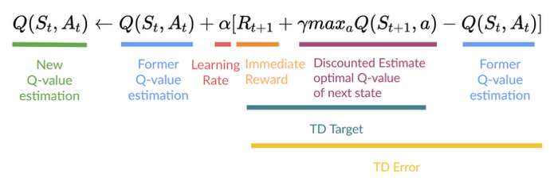
Q learning (2)

Slide 24
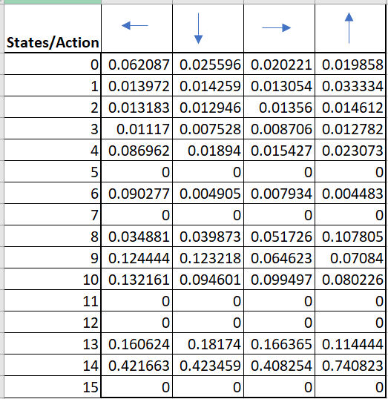
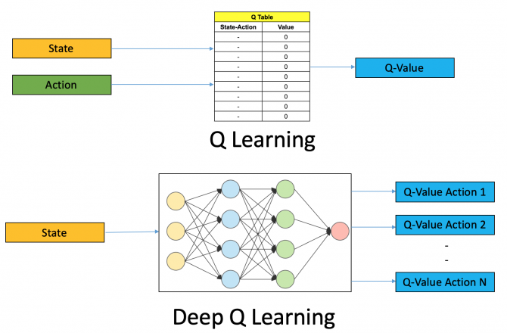

Q learning (3)

Slide 25
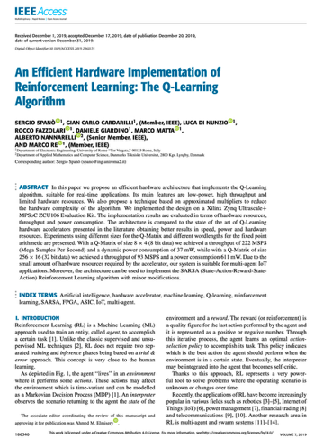
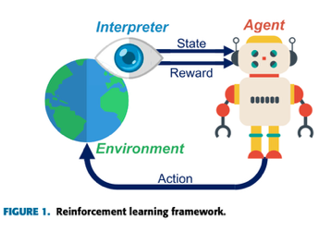
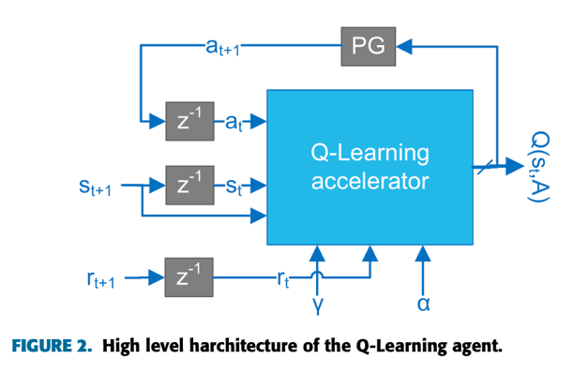
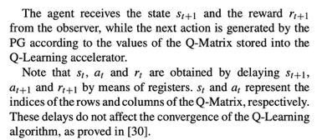
Efficient HW Q learning implementation
z⁻¹ = delay registers
https://doi.org/10.1109/ACCESS.2019.2961174

Slide 26
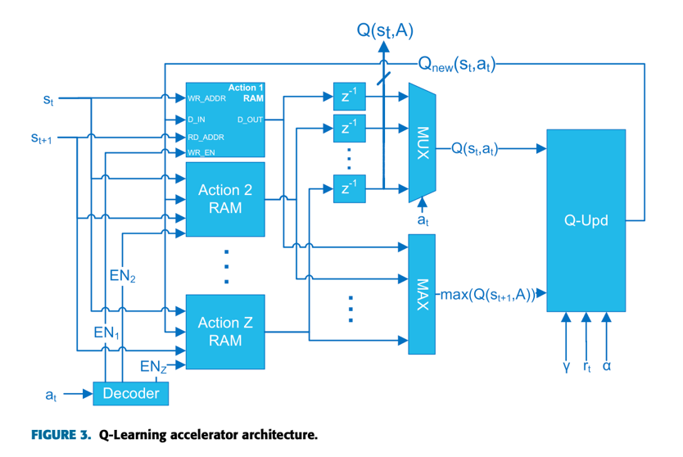
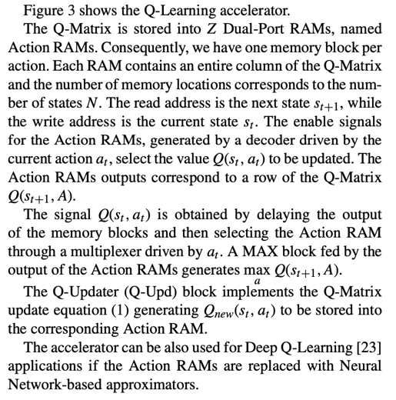
Efficient HW Q learning implementation
https://doi.org/10.1109/ACCESS.2019.2961174

Slide 27
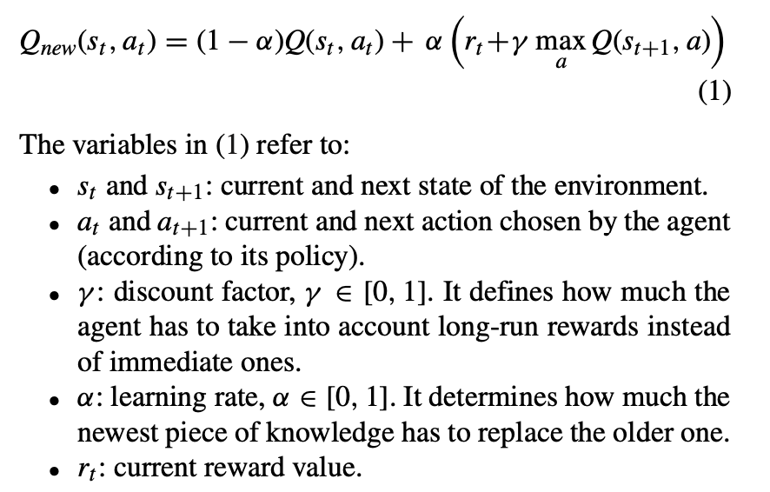
Efficient HW Q learning implementation
How many multipliers?
https://doi.org/10.1109/ACCESS.2019.2961174

Slide 28
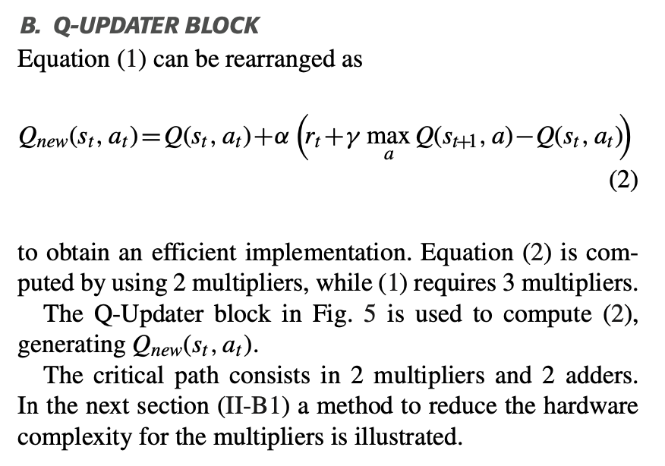
Efficient HW Q learning implementation
How many multipliers?
https://doi.org/10.1109/ACCESS.2019.2961174

Slide 29
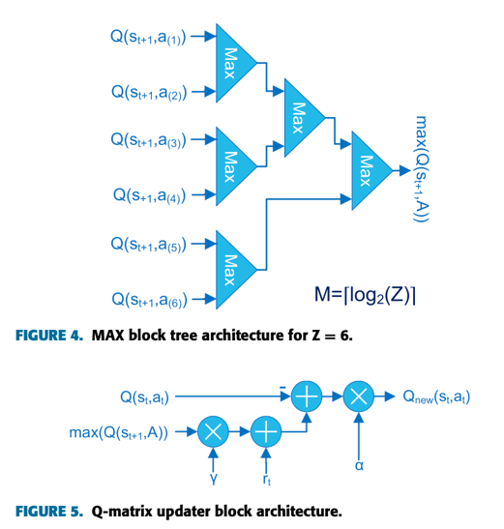
Efficient HW Q learning implementation
https://doi.org/10.1109/ACCESS.2019.2961174

Slide 30
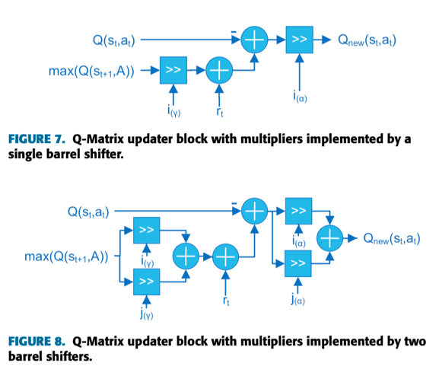
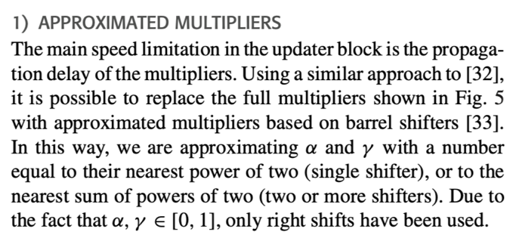
Efficient HW Q learning implementation
https://doi.org/10.1109/ACCESS.2019.2961174

